Slide 1

Introduction to Computers, Programs, and C++
TUIT
C++ Programming, Fall 2016
Lecture #1

Slide 2
TUIT
Roadmap
This week we will learn
Introduction
What is a Computer?
Programming Languages
Operating Systems
History of C++
A Simple C++ Program
C++ Program-Development Cycle
Programming Style and Documentation
Programming Errors

Slide 3


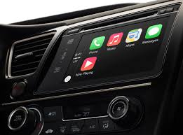
TUIT
What is Programming?
Programming means to create (or develop) software, which is also called a program.

Slide 4


TUIT
What is Software?
Software is all around you, even in devices that you might not think would need it!

Slide 5
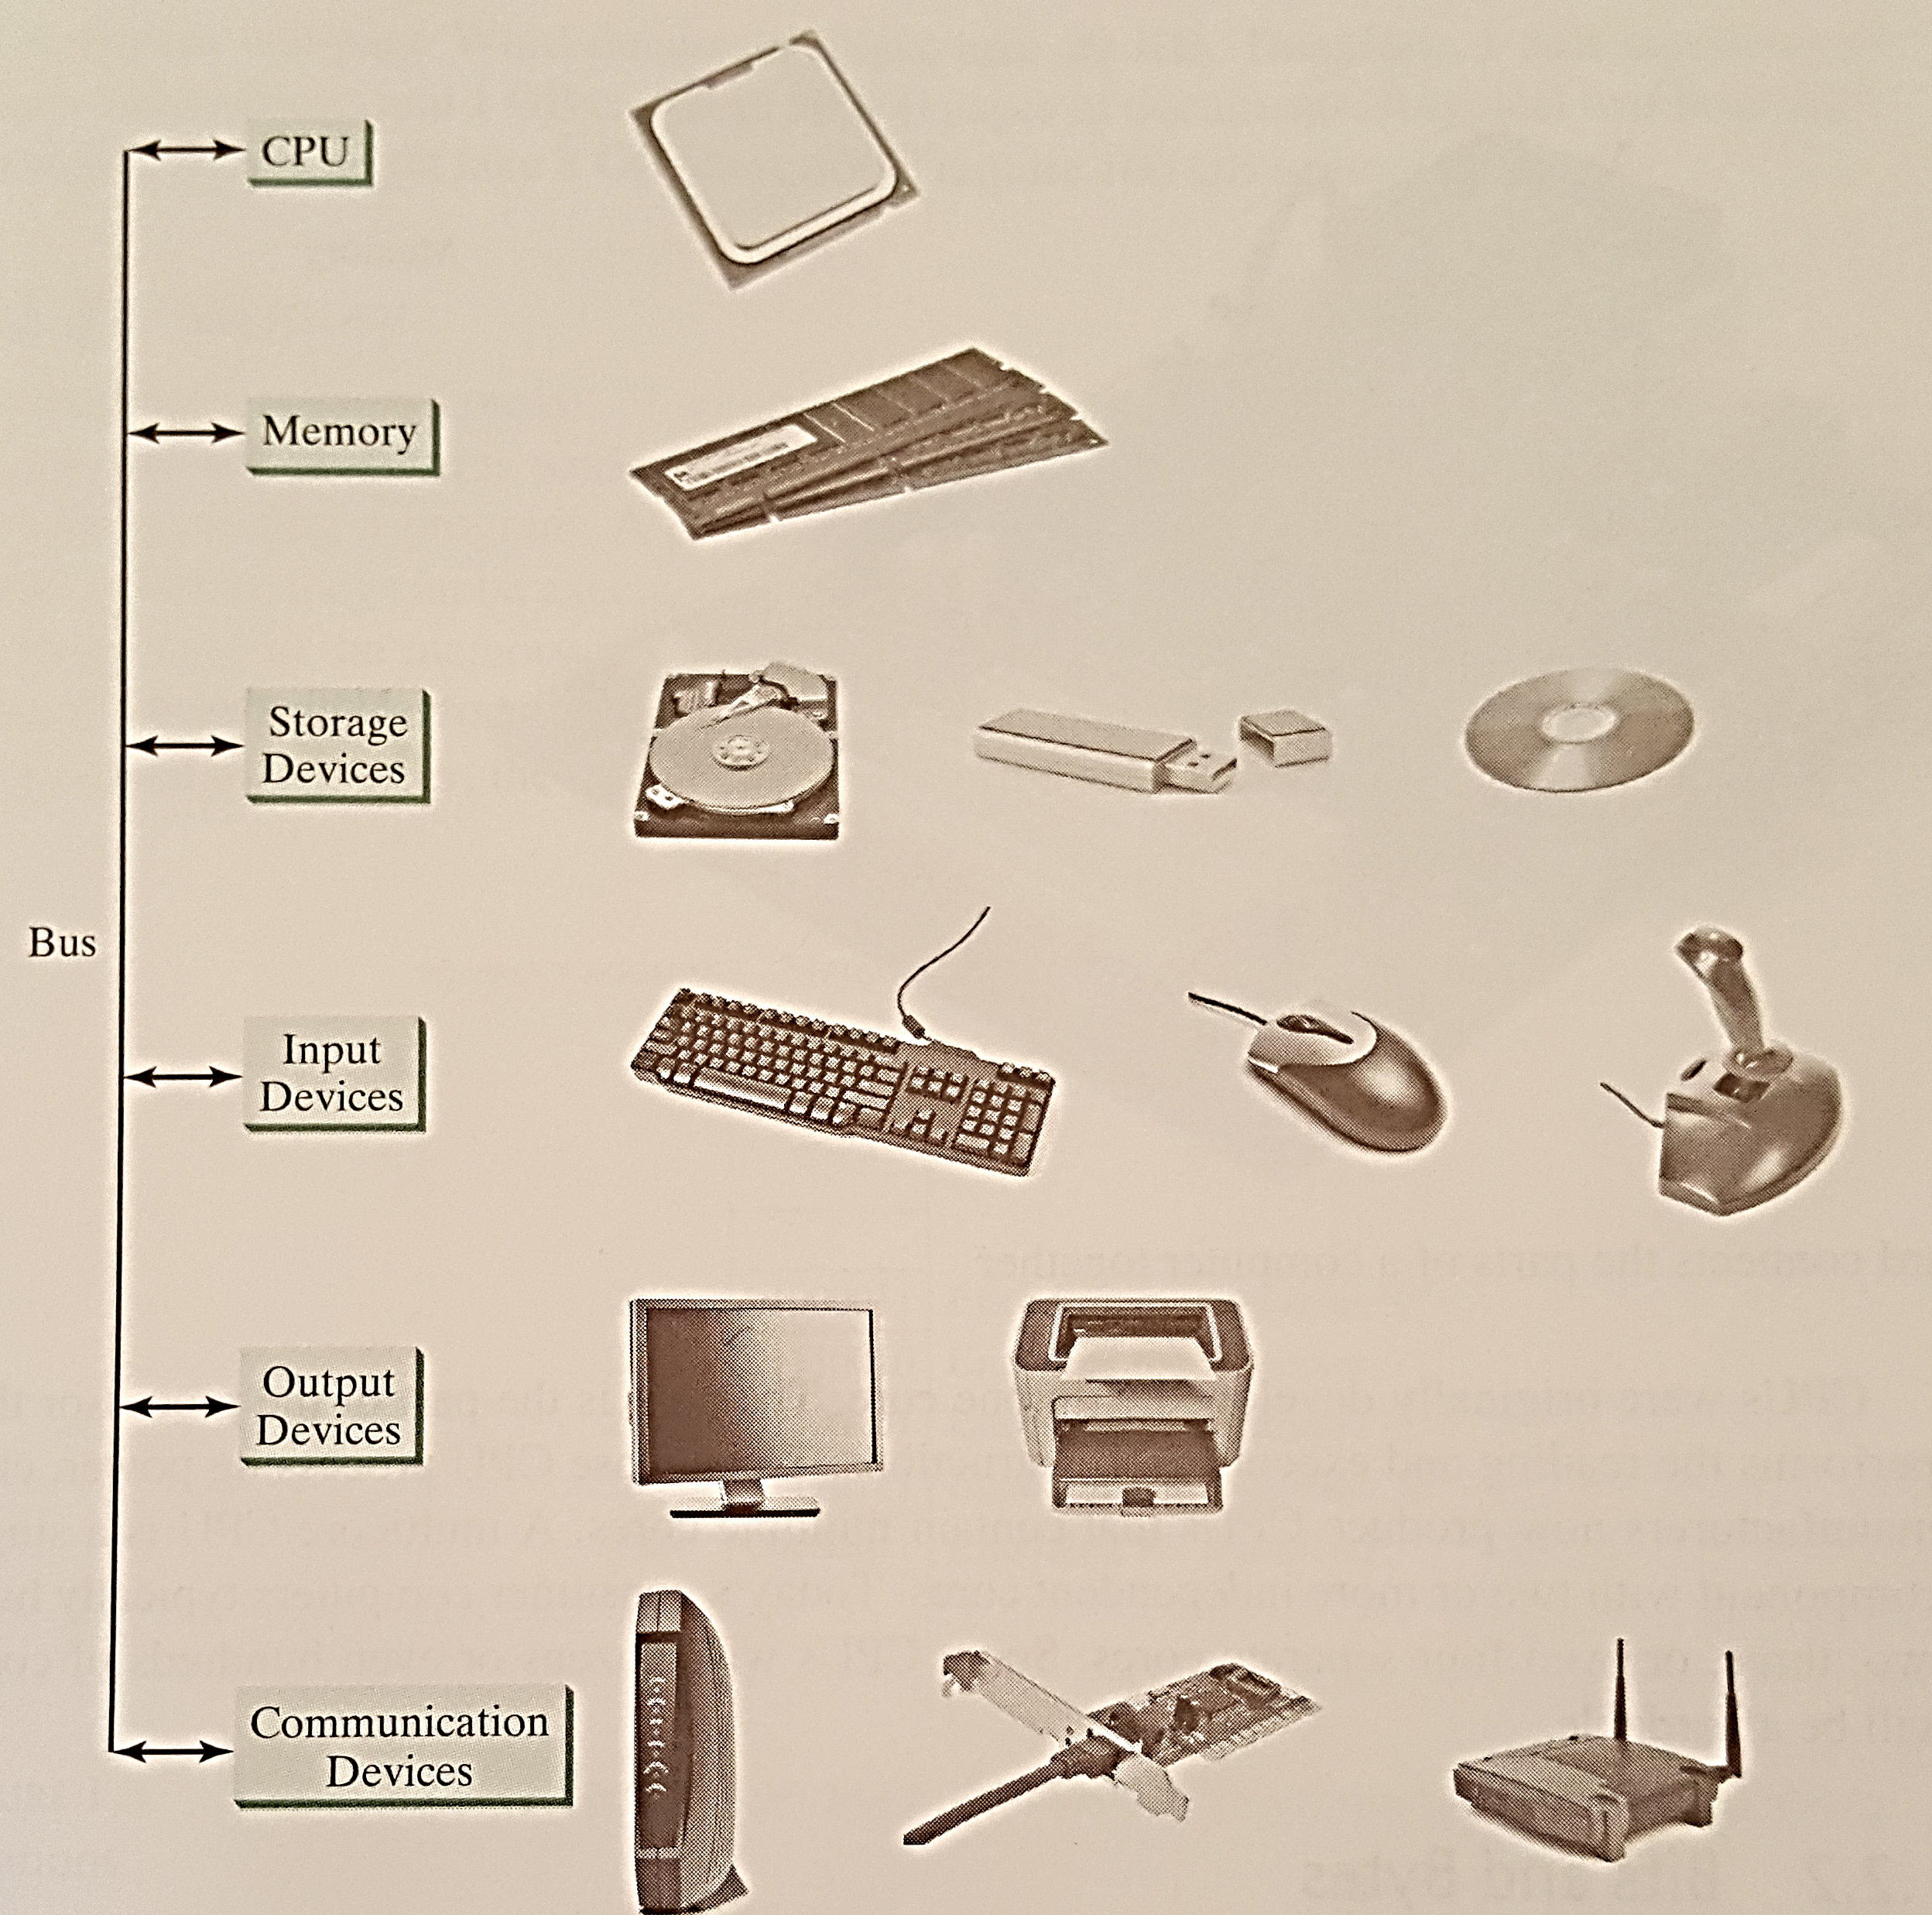
TUIT
What is Computer?
Computer is an electronic device that stores and processes data!
A computer includes hardware and software.

Slide 6
TUIT
What is Computer?
A computer consists of the following major hardware components:
Central processing unit (CPU)
Memory (main memory)
Storage devices (such as disks and CDs)
Input devices (such as the mouse and keyboard)
Output devices (such as monitors and printers)
Communication devices (such as modems and network interface cards)

Slide 7
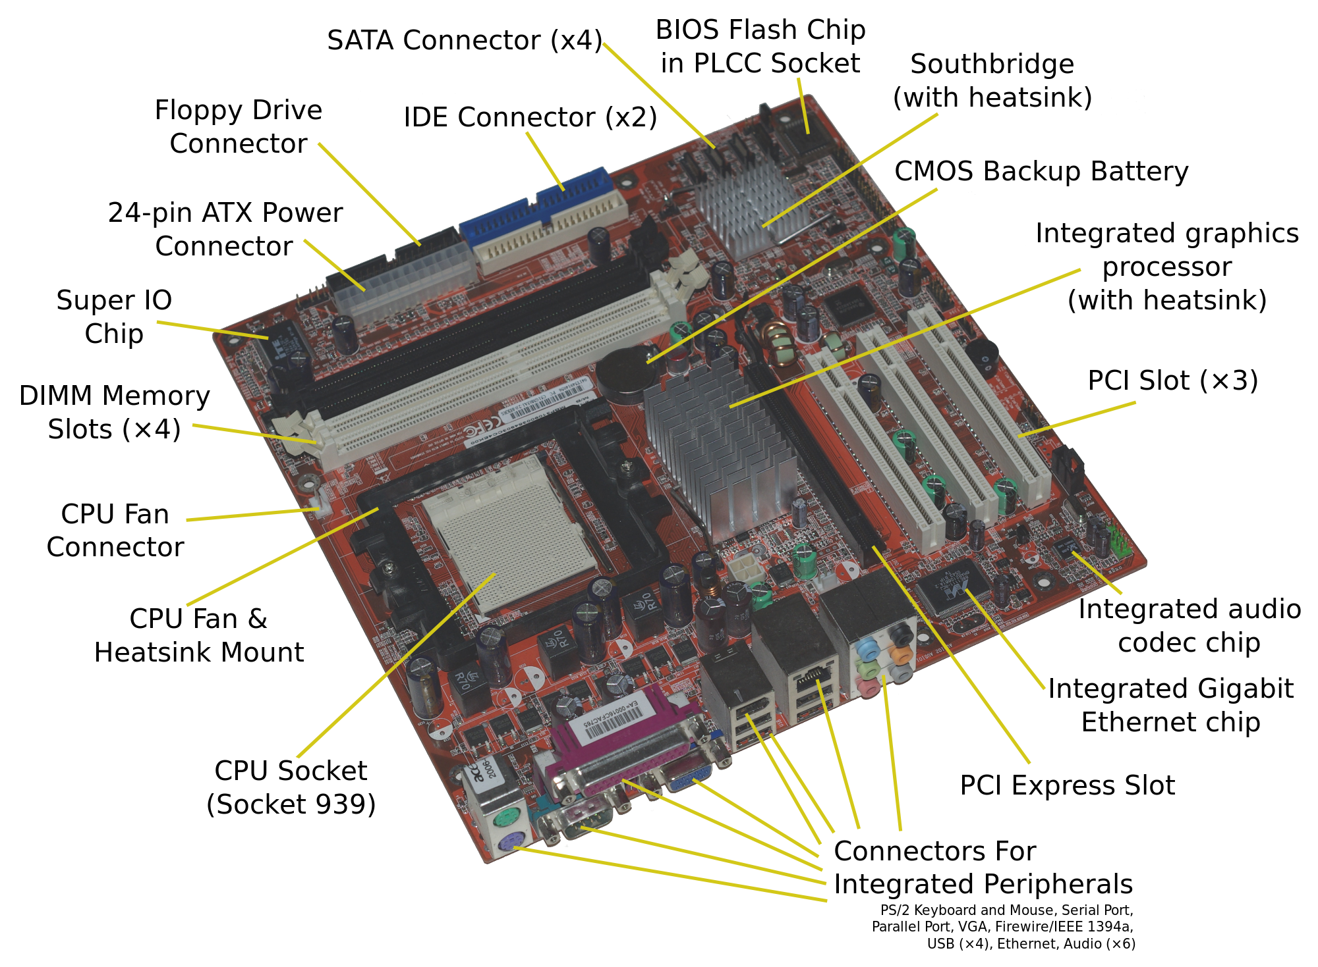
TUIT
Motherboard
A computer’s components are interconnected by a subsystem called a bus.
In personal computers, the bus is built into the computer’s motherboard.
The motherboard connects the parts of a computer together.

Slide 8
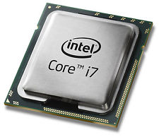
TUIT
Central Processing Unit
The Central Processing Unit (CPU) is the brain. IT retrieves instructions from memory and executes them.
The CPU usually has two components:
A control unit controls and coordinates the actions of the other components.
Arithmetic/logic unit (addition, substraction, multiplication, division and logical operations).
Every computer has an internal clock, which emits electronic pulses at a constant rate. CPU’s speed is Hertz (Hz).

Slide 9
TUIT
Bits and Bytes
A computer is really nothing more than a series of switches. Each switch exists in two states: on(1) or off (0).
Theses 0s and 1s are interpreted as digits in the binary number system and called bits (binary digits).
The minimum storage unit in a computer is a byte. A byte is composed of eight bits.
A kilobyte (KB) is about 1,000 bytes.
A megabyte (MB) is about 1 million bytes.
A gigabyte (GB) is about 1 billion bytes.
A terabyte (TB) is about 1 trillion bytes.

Slide 10
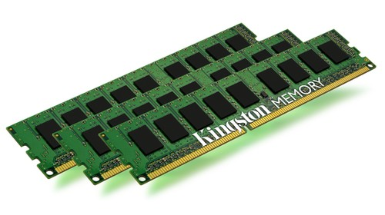
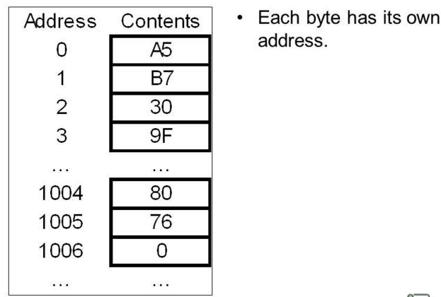
TUIT
Memory
A computer’s memory consists of an ordered sequence of bytes for storing programs as well as data that the program is working with.
Every byte in the memory has a unique address.
Memory stores data and program instructions in uniquely addressed memory locations.

Slide 11

TUIT
Storage Devices
There are three main types of storage devices:
Magnetic disk drives
Optical disc drives (CD and DVD)
USB flash drives

Slide 12


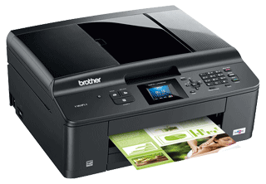
TUIT
Input and Output Devices
The most common input devices are keyboards and mice.
The most common output devices are monitors and printers.
input devices output devices

Slide 13
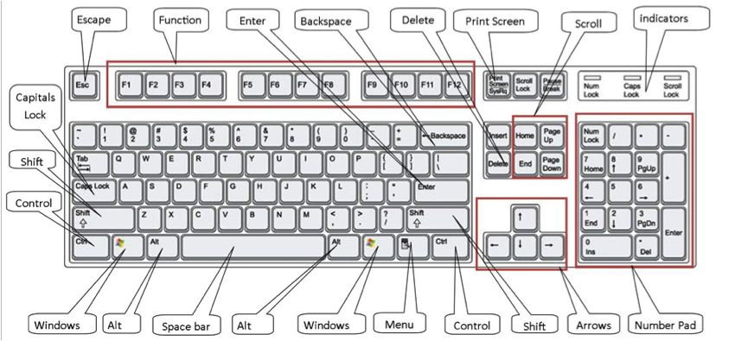
TUIT
Keyboard

Slide 14

TUIT
Mouse

Slide 15
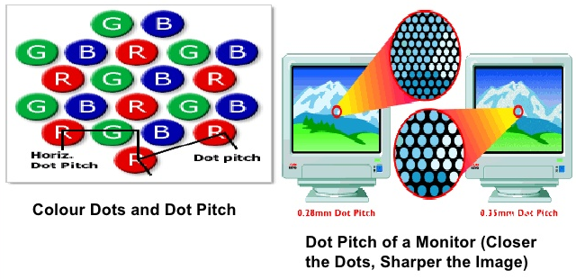
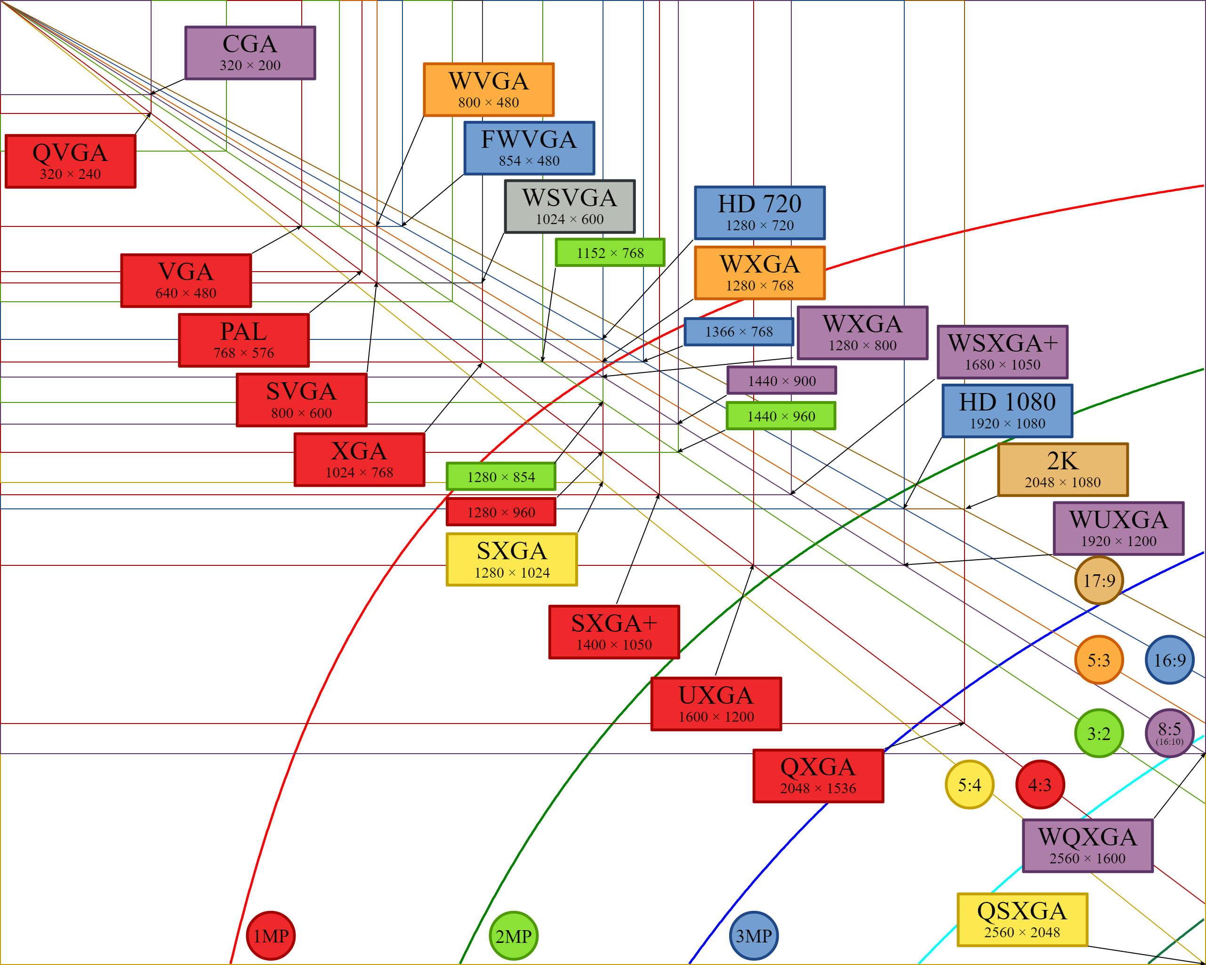
TUIT
Monitor

Slide 16
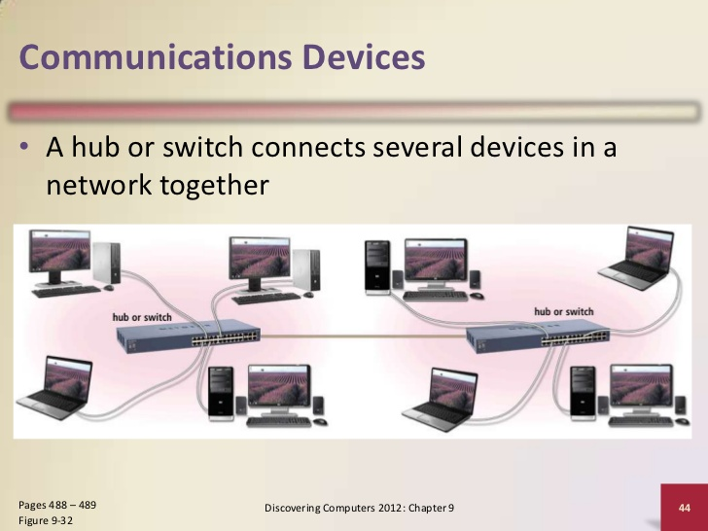
TUIT
Communication Devices
A dial-up modem (56,000 bps (bits per sedond) speed)
A digital subscriber line (DSL) (20times standart dial-up modem)
A cable modem (faster than DSL)
A network interface card (NIC) (1 million bps (mbps))
Wireless networking

Slide 17
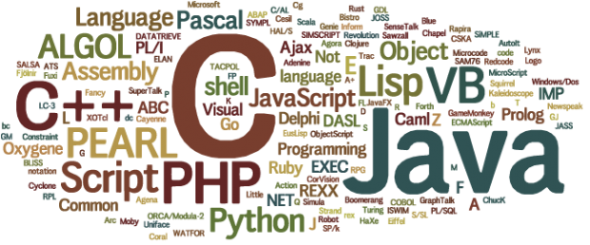
TUIT
Programming Languages
Computer programs. Known as software, are instructions that tell a computer what to do.
Computers do not understand human languages, so programs must be written in languages computers can understand.

Slide 18
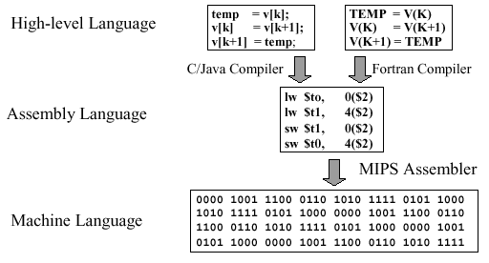
TUIT
Machine Language
A computer’s native language, which differs among different types of computers, is its machine language – a set of built-in primitive instructions.

Slide 19
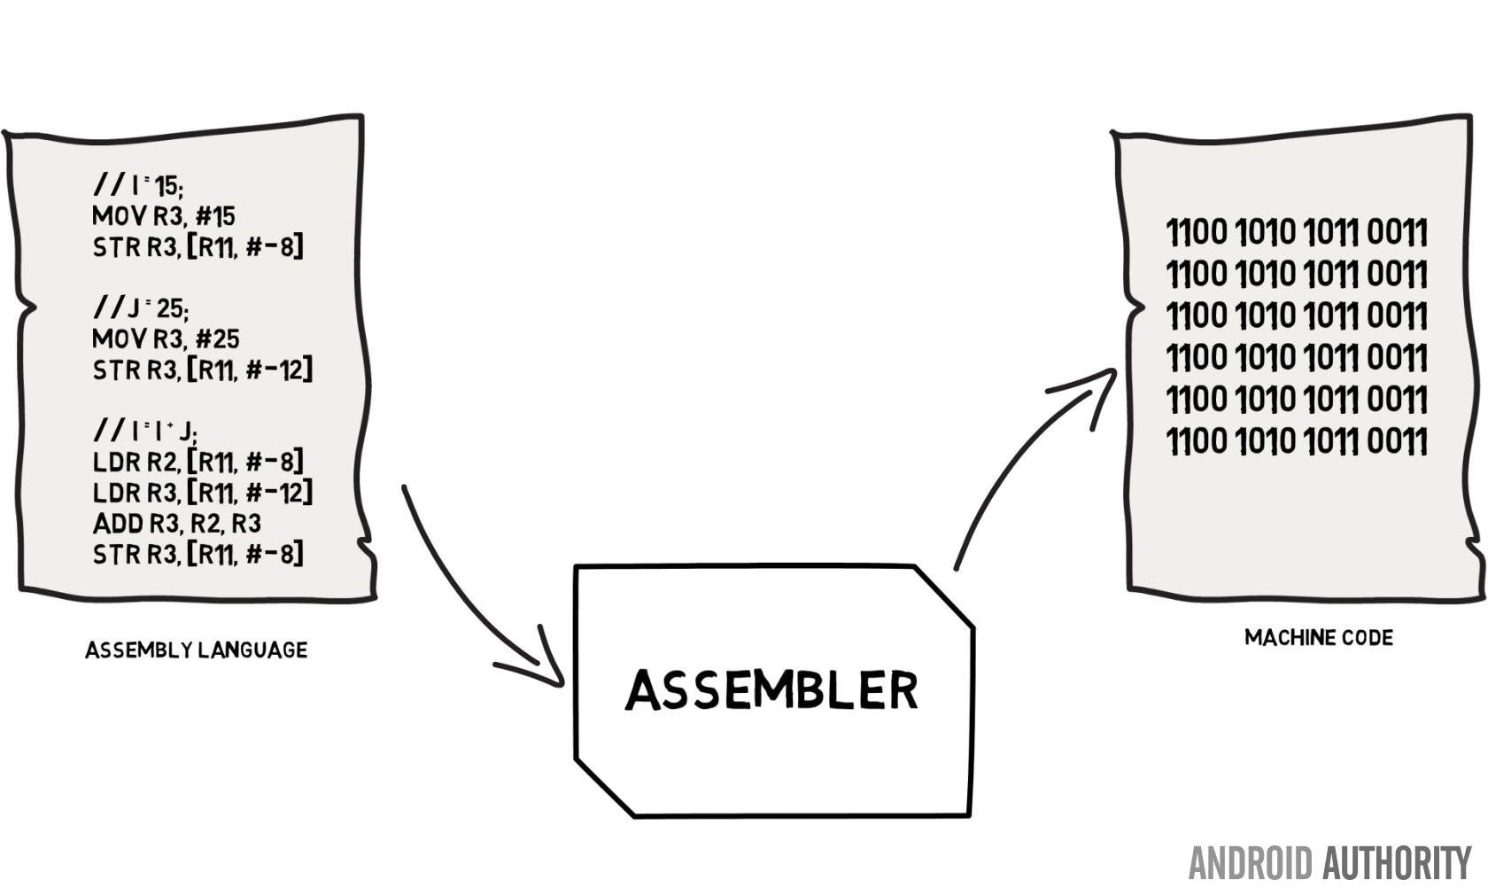
TUIT
Assembly Language
Programming in machine language is a tedious process. So, Assembly language was created in the early days of computing as an alternative to machine language. Writing in assembly requires that you know how the CPU works.

Slide 20
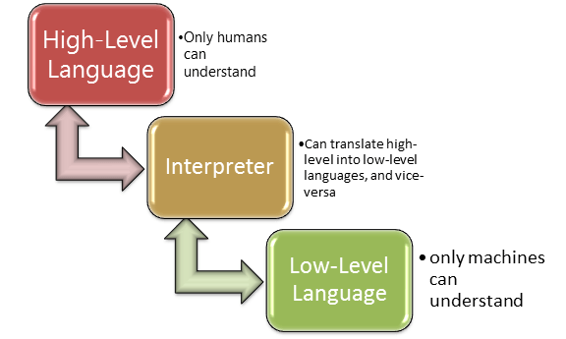
TUIT
High level language
In the 1950s, a new generation of programming languages known as high-level languages emerged. High level languages are English-like and easy to learn and use.

Slide 21
TUIT
Popular High-Level Programming language
Language | Description
Ada | Named for Ada Lovelace, who worked on mechanical general-purpose computers. The Ada language was developed for the Department of Defense and is used mainly in defense projects.
BASIC | Beginner’s All-purpose Symbolic Instruction Code. It was designed to be learned and used easily by beginners
C | Developed at Bell laboratories. C combines the power of an assembly language with the ease of use and portability of a high-level language
C++ | C++ is an object-oriented language, based on C
C# | Pronounced “C Sharp”. It is a hybrid of Java and C++ and was developed by Microsoft

Slide 22
TUIT
Popular High-Level Programming language
Language | Description
COBOL | Common Business Oriented Language. It is used for business applications.
FORTRAN | FORmula TRANslation. It is popular for scientific and mathematical applications.
Java | Developed by Sun Microsystems, now part of Oracle. It is widely used for developing platform-independent Internet applications.
Pascal | Named for Blaise Pascal, who pioneered calculating machines in the seventeenth century. It is a simple, structured, general-purpose language primarily used for teaching programming
Python | A simple general-purpose scripting language good for writing short programs.
Visual Basic | Visual Basic was developed by Microsoft and it enables the programmers to rapidly develop graphical user interfaces.

Slide 23
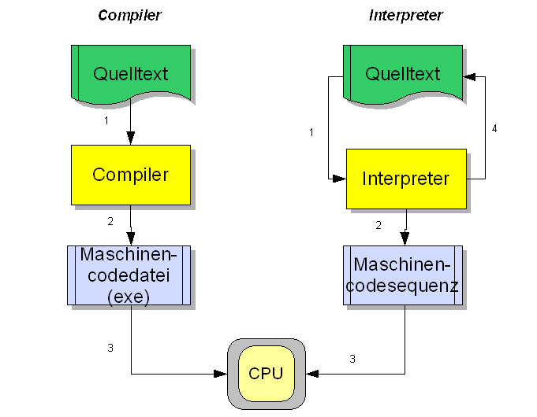
TUIT
Interpreter, Compiler
Interpreter – Translates instructions to machine code line-by-line.
Compiler – Translates the entire program to machine code before running it

Slide 24
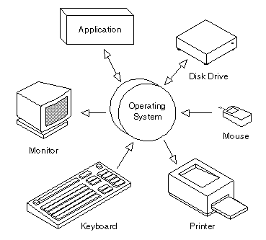
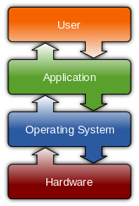
TUIT
Operating Systems
The operating system (OS) is the most important program that runs on a computer.
The OS manages and controls a computer’s activities

Slide 25

TUIT
Operating Systems
The following are major tasks of an operating system:
Controlling and monitoring system activities;
Allocating and assigning system resources;
Scheduling operations.

Slide 26
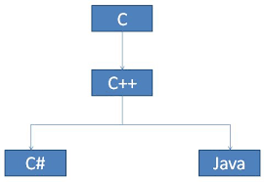
TUIT
History of C++
C++ is a general-purpose, object-oriented programming language.
C, C++, Java, and C# are related;
C++ evolved from C;
Java was modeled after C++;
C# is a subset of C++;

Slide 27
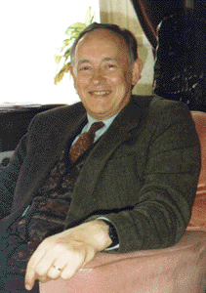
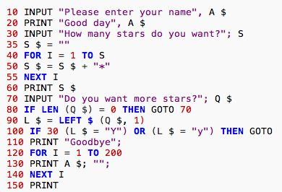
TUIT
History of C++
C evolved from the B language, which evolved from the BCPL (Basic Combined Programing Language). Martin Richards developed BCPL in the mid-1960s for writing operating systems and compilers;
Martin Richards
BCPL language

Slide 28
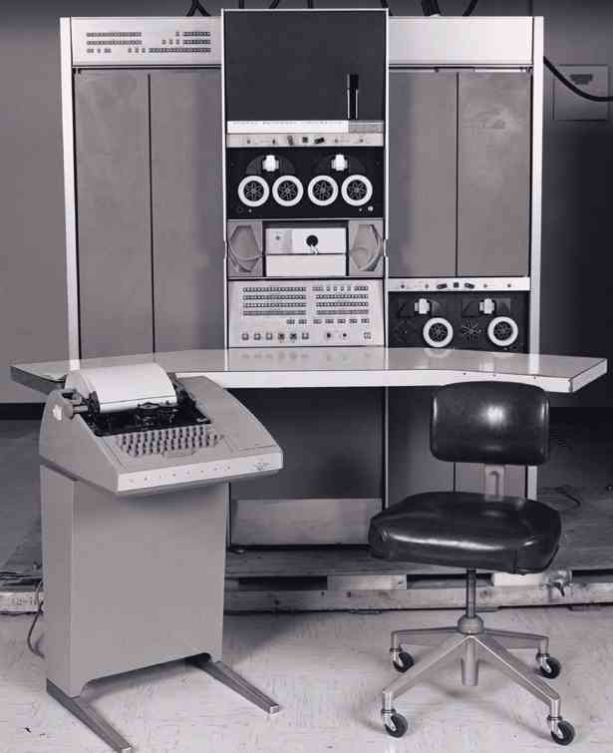
TUIT
History of C++
Ken Thompson incorporated many features from BCPL in his B language and used it to create early versions of the UNIX operating system at Bell Laboratories in 1970 on a DEC PDP-7 computer;
DEC PDP-7 minicomputer.

Slide 29
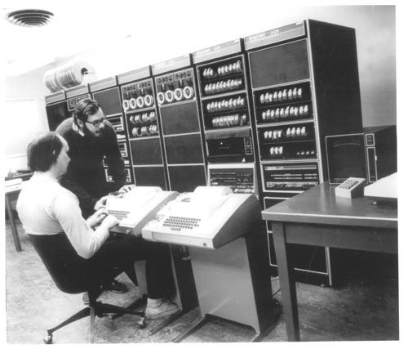
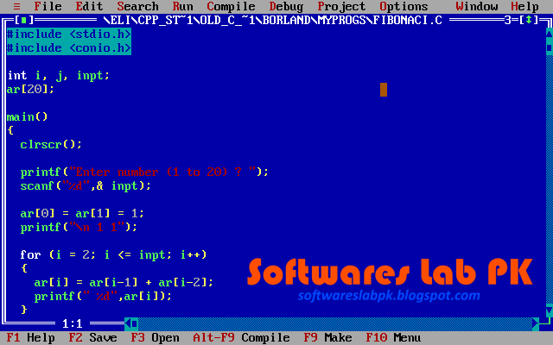
TUIT
History of C++
Dennis Ritchie extended the B language by adding types and other features in 1971 to develop the UNIX operating system on a DEC PDP-11 computer. Today, C is portable and hardware independent.
UNIX inventors Ken Thompson and Dennis Ritchie at Bell Labs before a DEC PDP-11 minicomputer.
C compiler

Slide 30

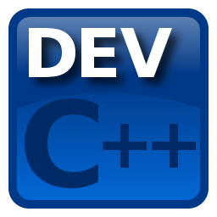
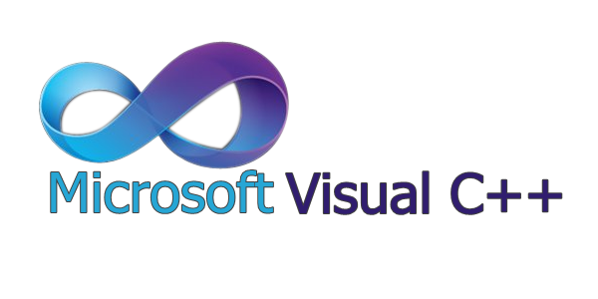
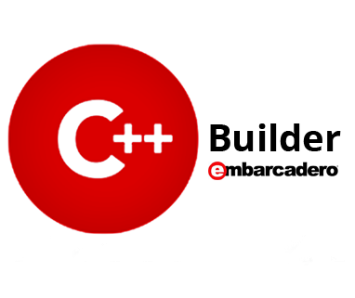
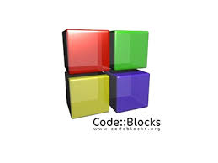
TUIT
History of C++
C++ is an extension of C, developed by Bjarne Stroustrup at Bell Laboratories during 1983-1985.
An international standard for C++, known as C++98, was created by International Standart Organization (ISO) in 1998.
A new standart, known as C++11, was approved by ISO in 2011.
C++ inventor Bjarne Stroustrup
Compilers for C++ language

Slide 31
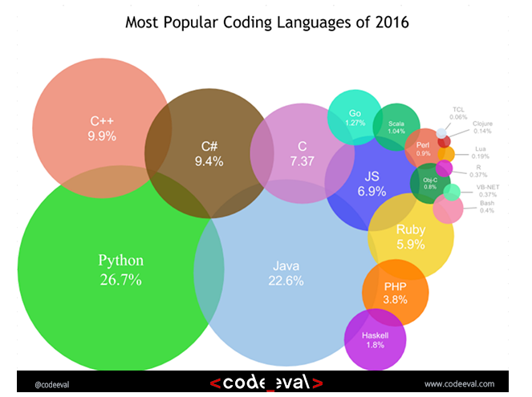
TUIT
Popular coding Languages

Slide 32
TUIT
A Simple C++ Program
Welcome.cpp
1 #include <iostream>
2 using namespace std;
3
4 int main()
5 {
6 // Display Welcome to C++ to the console
7 cout << “Welcome to C++!” << endl;
8
9 return 0;
10 }
Welcome to C++!

Slide 33
TUIT
A Simple C++ Program
Single-line comments
Function main returns an integer value
Preprocessor directive to include input/output stream header file <iostream>
Left brace { begins function body
Function main appears exactly once in every C++ program
Statements end with a semicolon ;
Corresponding right brace } ends function body
Stream insertion operator
Name cout belongs to namespace std
Keyword return is one of several means to exit a function; value 0 indicates that the program terminated successfully

Slide 34
TUIT
A Simple C++ Program
Keywords or reserved words, have a specific meaning to the compiler and cannot be used in the program for other purposes. There are four keywords in this program: using, namespace, int, and return.
Preprocessor directives are not C++ statements. Therefore, don’t put semicolons at the end of preprocessor directives. Doing so may cause subtle errors.
Some compilers will not compile if you put extra spaces between <and iostream or between iostream and>. The extra space will become part of the header file name. To ensure your program will work with all compilers, don’t put extra spaces in these cases.
C++ source programs are case sensitive. It would be wrong, for example. To replace main in the program with Main.

Slide 35
TUIT
Special Characters
Character | Name | Description
# | Pound sign | Used #include to denote a preprocessor directive.
<> | Opening and closing angle brackets | Encloses a library name when used with #include
() | Opening and closing parentheses | Used with functions such as main()
{} | Opening and closing braces | Denotes a block to enclose statements
// | Double slashes | Precedes a comment line
<< | Stream insertion operator | Outputs to the console
“ “ | Opening and closing quotation marks | Wraps a string (i. e., sequence of characters)
; | Semicolon | Marks the end of a statement

Slide 36
TUIT
WelcomeWithThreeMessages.cpp
1 #include <iostream>
2 using namespace std;
3
4 int main()
5 {
6 cout << “Programming is fun!” << endl;
7 cout << “Fundamentals First!” << endl;
cout << “Problem Driven” << endl;
10 return 0;
11 }
Programming is fun! Fundamentals First! Problem Driven

Slide 37
TUIT
WelcomeWithThreeMessages.cpp
1 #include <iostream>
2 using namespace std;
3
4 int main()
5 {
6 cout << “(10.5 + 2 * 3) / (45 – 3.5) = ”;
7 cout << (10.5 + 2 * 3) / (45 – 3.5) << endl;
9 return 0;
10 }
(10.5 + 2 * 3) / (45 – 3.5) = 0.39759036144578314
You can combine multiple outputs in a single statement. For example, the following statement performs the same function as lines 6 – 7.
cout << “(10.5 + 2 * 3) / (45 – 3.5) = ”
<< (10.5 + 2 * 3) / (45 – 3.5) << endl;

Slide 38
TUIT
Check Point
Show the output of the following code:
1 #include <iostream>
2 using namespace std;
3
4 int main()
5 {
6 cout << ”3.5 * 4 / 2 – 2.5 = “ << (3.5 * 4 / 2 – 2.5) << endl;
9 return 0;
10 }

Slide 39
TUIT
C++ Program-Development Cycle
The C++ program-development process consists of creating/modifying source code, compiling, linking and executing programs.
C++ compiler contains three tasks in sequence: preprocessor, compiling, and linker.
A preprocessor is a program that processes a source file before it is passed down to the compiler.
The compiler then translates the intermediate file into a machine-code file.
The linker links the machine-code file with supporting library files to from an executable file.

Slide 40
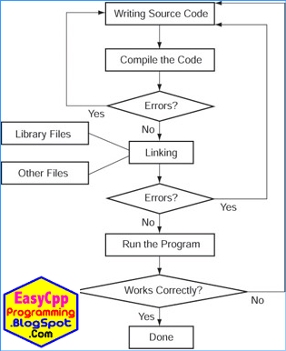
TUIT
C++ Program-Development Cycle

Slide 41
TUIT
Programming style and documentation
Good programming style and proper documentation make a program easy to read and help programmers prevent errors.
Programming style deals with what programs look like. A program could compile and run properly even if you wrote it on one line only, but writing it that way would be bad programming style because it would be hard t read.
Documentation is the body of explanatory remarks and comments pertaining to a program.

Slide 42
TUIT
Appropriate Comments and Comment Styles
Include a summary at the beginning of the program to explain what the program does, its key features, and any unique techniques it uses.
In a long program , you should also include comments that introduce each major step and explain anything that is difficult to read.
It is important to make comments concise so that they do not crowd the program or make it difficult to read.

Slide 43
TUIT
Proper Indentation and Spacing
A consistent indentation style makes programs clear and easy to read, debug, and maintain. Indentation is used to illustrate the structural relationships between a program’s components or statements.
C++ compiler can read the program even if all the statements are in a straight line, but properly aligned code is easier to read and maintain.
cout << 3+4*4;
Bad Style
cout << 3 + 4 * 4;
Good Style

Slide 44
TUIT
Check Point
Identify and fix the errors in the following code:
1 #include <iostream>
2 using namespace std;
3
4 int main
5 {
6 // Display Welcome to C++ to the console
7 cout << “Welcome to C++!” << endl;
8
9 return 0;
10 }

Slide 45
TUIT
Programming Errors
Programming errors can be categorized into three types: syntax errors, runtime errors, and logic errors.
Programming errors are unavoidable, even for experienced programmers. Errors can be categorized into three types: syntax errors, runtime errors, and logic errors.

Slide 46
TUIT
Syntax Errors
Errors that are detected by the compiler are called syntax errors or compile errors. ShowSyntaxErrors.cpp
1 #include <iostream>
2 using namespace std
3
4 int main
5 {
6 cout << “Welcome to C++!” << endl;
7
8 return 0;
9 }
Syntax errors result from errors in code construction, such as mistyping a keyword, omitting necessary punctuation, or using an opening brace without a corresponding closing brace.

Slide 47
TUIT
Syntax Errors
When you compile this program using Visual C++, it displays the following errors:
Compile
1>ShowSyntaxErrors.cpp(4): error C2144: syntax error : ‘int’ should be preceded by ‘;’ 1>ShowSyntaxErrors.cpp(6): error C2001: newline in constant 1>ShowSyntaxErrors.cpp(4): error C2143: syntax error : missing ‘;’ before ‘return’
Three errors are reported, but the program actually has two errors. First, semicolon (;) is missing at the end of line 2. Second, the string Programming is fun should be closed with a closing quotation mark in line 6.

Slide 48
TUIT
Runtime Errors
Runtime errors cause a program to terminate abnormally.
ShowRuntimeErrors.cpp
1 #include <iostream>
2 using namespace std
3
4 int main()
5 {
6 int i = 4;
7 int j = 0;
8 cout << i / j << endl;
9
10 return 0;
11 }
Here i and j are called variables. i has a value of 4 and j has a value 0. i / j in line 8 causes a runtime error of division by zero.

Slide 49
TUIT
Logic Errors
Logic errors occur when a program does not perform the way it was intended. Errors of this kind occur for many different reasons. For example, suppose you wrote the following program to convert a Celsius 35 degree to a Fahrenheit degree:
ShowLogicErrors.cpp
1 #include <iostream>
2 using namespace std
3
4 int main()
5 {
6 cout << “Celsius 35 is Fahrenheit degree ” << endl;
7 cout << (9 / 5) * 35 + 32 << endl;
8
9 return 0;
10 }
Celsius 35 is Fahrenheit degree 67
You will get Fahrenheit 67 degree, which is wrong. It should be 95. In C++, the division for integers is the quotient. The fractional part is truncated. So 9 / 5 is 1. To get the correct result, you need to use 9.0 / 5 , which result in 1.8.

Slide 50
TUIT
Common Errors
Missing a closing brace, missing a semicolon, missing quotation marks for strings, and misspelling names are common errors made by new programmers.
Common Error 1: Missing Braces
1 int main()
2 {
3 }
Type this closing brace right away to match the opening brace
Common Error 2: Missing Semicolons
1 int main()
2 {
cout << “Programming is fun” << endl;
cout << “Fundamentals First” << endl;
cout << “Problem Driven” << endl
6 return 0;
7 }
Missing a semicolon

Slide 51
TUIT
Common Errors
Common Error 3: Missing Quotation Marks
cout << “Problem Driven;
Missing a quotation mark
Common Error 4: Misspelling Names
1 int Main()
2 {
cout << (10.5 + 2 * 3) / (45 – 3.5) << endl;
4 return 0;
5 }

Slide 52
TUIT
Summary
A computer is an electronic device that strores and processes data
A computer includes both hardware and software.
The central processing unit (CPU) is a computer’s brain.
A bit is a binary digit 0 or 1.
Memory stores data and program instructions for the CPU to execute.
Machine language is a set of primitive instructions built into every computer.
Assembly language is a low-level programming language in which a mnemonic is used to represent each machine –language instruction.
High-level language is a low-level programming language in which a mnemonic is used to represent each machine-language instruction.
High-level languages are English-like and easy to learn and program.
A compiler is a software program that translates the source program into a machine-language program.
The operating system (OS) is a program that manages and controls a computer’s activities.

Slide 53
TUIT
Summary
C++ is an extention of C. C++ source files end with the .cpp extension.
#include is a preprocessor directive. All preprocessor directives begin with the symbol #.
The cout object along with the stream insertion operator (<<) can be used to display a string on the console.
Every C++ program is executed from a main function. A function is a construct that contains statements.
Every statement in C++ must end with a semicolon (;), known as the statement terminator.
In C++, a comment is a preceded by two slashes (//) on a line, called a line comment, or enclosed between /* and */ on one or several lines, called a block comment or paragraph comment.
Keywords, or reserved words, have a specific meaning to the compiler and cannot be used in the program for other purposes. Examples, using, namespace, int, and return.
Programming errors: syntax errors, runtime errors, and logic errors.

